Slide 1
Distance Warning System
Lab Section D Group 3
ECE 372A - Microcontroller Organization Electrical and Computer Engineering University of Arizona

Slide 2
Team Members
Kai:
I2C, LCD, Ultrasonic sensor
Luis:
PWM, Buzzer, LEDs, Ultrasonic sensor
Alex:
Power Saving
Everyone:
Final prototype design, and circuit

Slide 3
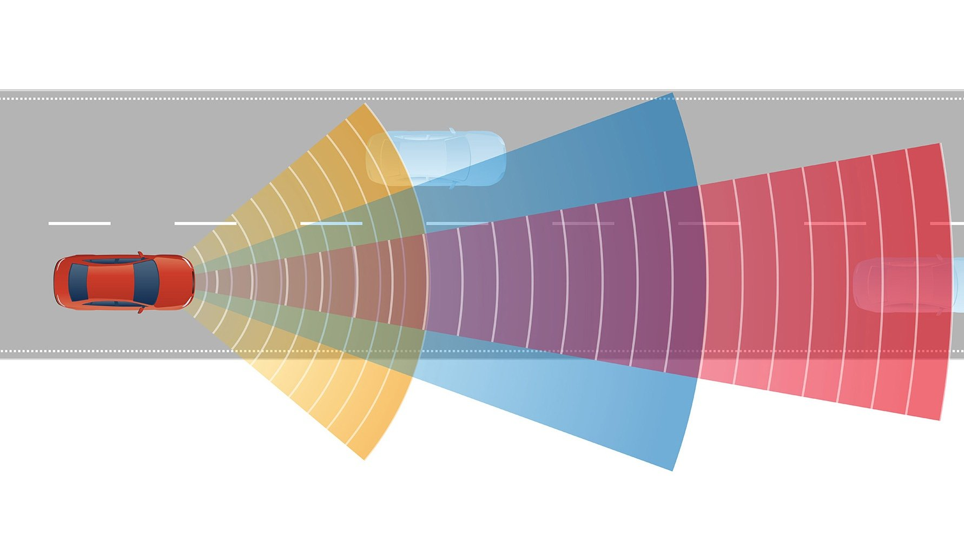
Problem
Many cars made today come with sensors that detect and warn the driver of their car’s proximity to objects. These sensors warn the driver about getting too close to an object to before a collision occurs. However, these sensors are only a recent development, and may only be available on more expensive car models that people may not be able to afford.

Slide 4
Proposed Solution
The proposed solution for this problem is a small distance sensor utilizing an ultrasonic sensor in order to measure distances between the sensor and object.
The user will be able to see the measured distance of an object on an LCD screen.
The user will also get additional feedback through LEDs and a buzzer.

Slide 5
Requirements
Requirement 1: Distance measurement
The device will need to be able to determine the distance between itself and an object in front of it, and also display the measured distance on the LCD while not using external libraries.
Requirement 2: Battery Powered
The device will need to be powered through a separate battery that can be replaced.
Requirement 3: Buzzer/LED activation
The green LED will activate when the distance measured is greater than 5 feet. The yellow LED will activate between 5 and 2 feet. The buzzer and red LED will activate when the distance found between the car and object is 2 feet or less.
Requirement 4: I2C LCD
The LCD must utilize the I2C communication protocol and display distance and text while not using external libraries.

Slide 6
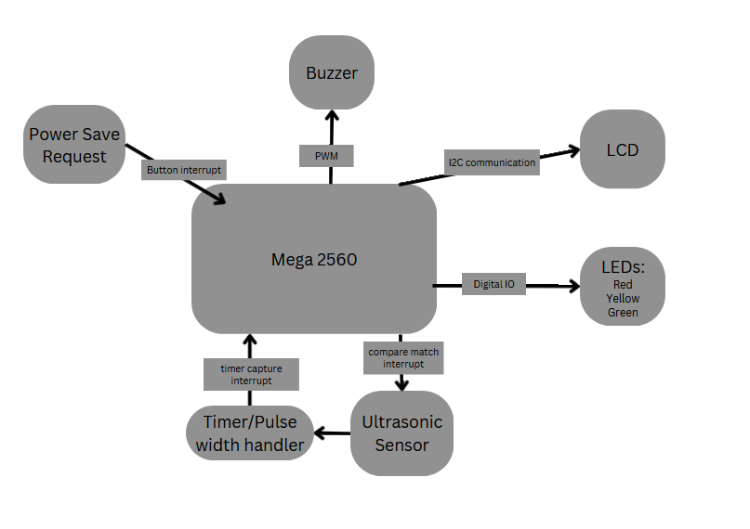
System Architecture Diagram
LCD: Displays distance from sensor
Ultrasonic Sensor: Calculates distance from object
LEDs: Depending on which color is turned on you can estimate your distance
Buzzer: High pitched noise will be heard if you get too close to an object
Power Save Request: Allows for user to place device in power save mode

Slide 7
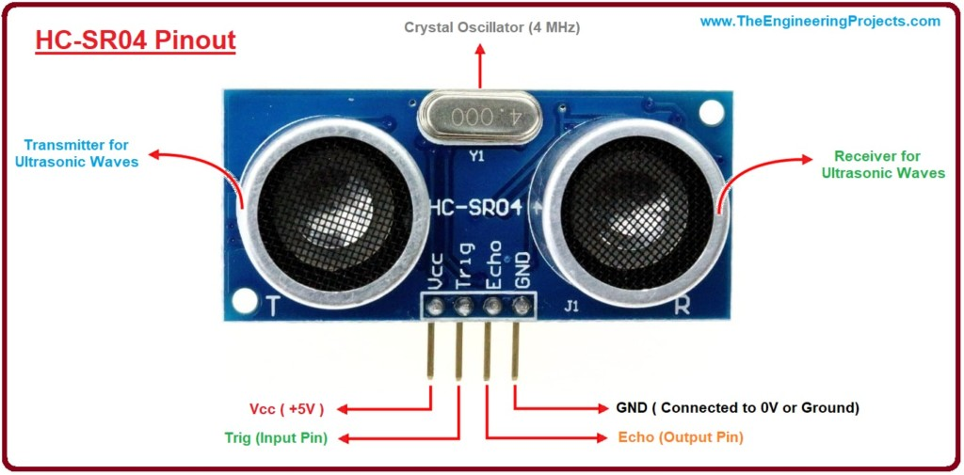
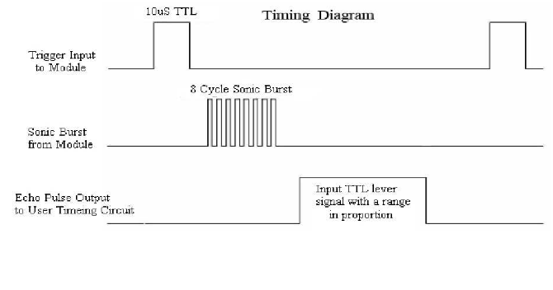
Input Sensors: Ultrasonic Sensor
HC - SR04 Ultrasonic Sensor
Input sensor used to measure distance
Operating Voltage of 5 V
Operating current of 15 mA
Dimensions: 45 * 20 * 15 mm
Max range of 4 meters or around 13 feet

Slide 8
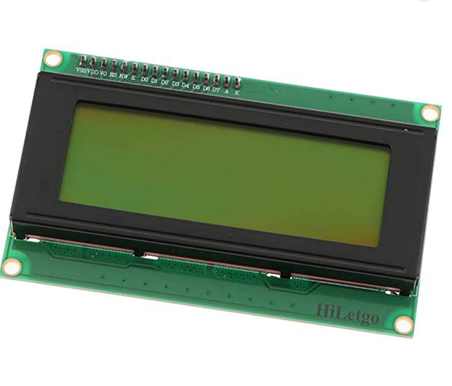
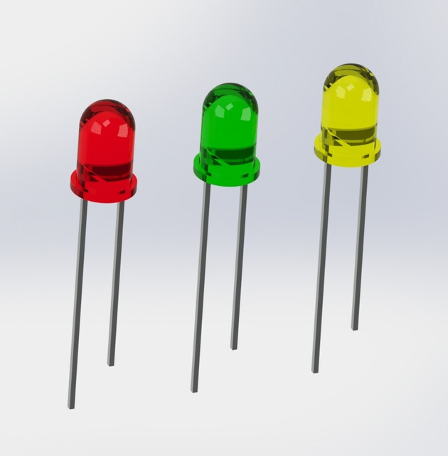
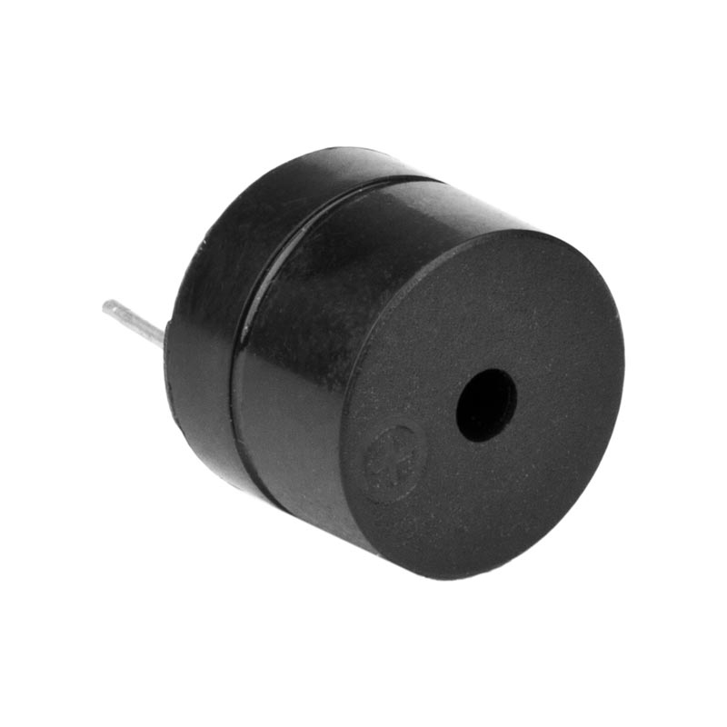
Output
LCD:
Display the distance measured from the ultrasonic sensor in feet
LEDs:
Different LEDs will turn on at different predetermined distance measurements
Allows for quick analysis of distance from sensor to object
Red: Distance ≤ 2 feet
Yellow: Distance between 2 and 5 feet
Green: Distance ≥ 5 feet
Active Buzzer:
Will activate when distance from object is less than or equal to 2 feet

Slide 9
Program Functionality
Buzzer.cpp/PWM.cpp:
Activates/deactivates buzzer.
Turns on PWM for buzzer.
I2C.cpp:
Initializes I2C protocol and sends data from board to LCD.
LCD_I2C.cpp:
Initializes LCD and has functions for writing to the display using I2C.
LED.cpp:
Initializes LEDs and checks to see which LED should be turned on.
Power_save.cpp:
Turns off non-essential processes and turns them back on.
Timer.cpp:
Turns on timer 0 and 1 for millisecond delay and microsecond delay.
Turns on timer 4 for ultrasonic sensor.
Ultrasonic.cpp:
Initializes the ultrasonic module and calculates distance in feet and meters.

Slide 10
Sleep Mode and Power Saving
Power-Save Mode
Timers can be left running and its woken up from a timer overflow or Timers can be off and its woken up by a PCINT
SM2 is 0, SM1 is 1 and SM0 is 1. SMCR |= (1 << SM1) and SMCR |= (1 << SM0)
SMCR stands for Sleep Mode Control Register.
Sleep Enable
SE = 1 is for putting it in Power-Save Mode and SE = 0 is to wake it up from Power-Save Mode.
SMCR|= (1 << SE) for off and SMCR |= (1 << SE) for on.
SE stands for Sleep Enable.
Power Reduction Timer/Counter
PRTIM0 when equal to 1 the timer will continue on like normal but when equal to 0 the timer is off.
PRR0 |= (1 << PRTIM0) and PRR0 &= ~(1 << PRTIM0) .
PRR0 stands for Power Reduction Register.

Slide 11
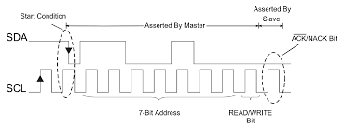
Communication Protocol
The I2C protocol was used for displaying information about distance on the LCD

Slide 12
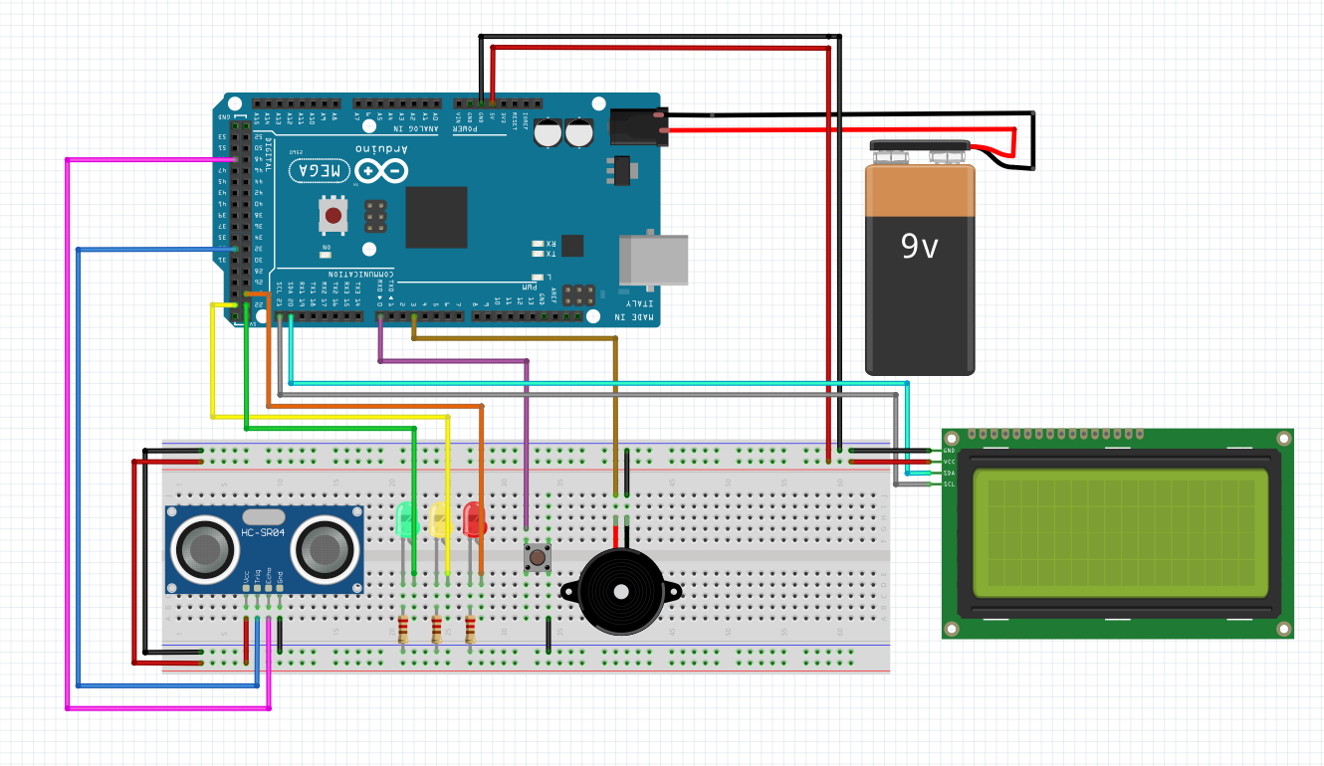
Circuit Design

Slide 13
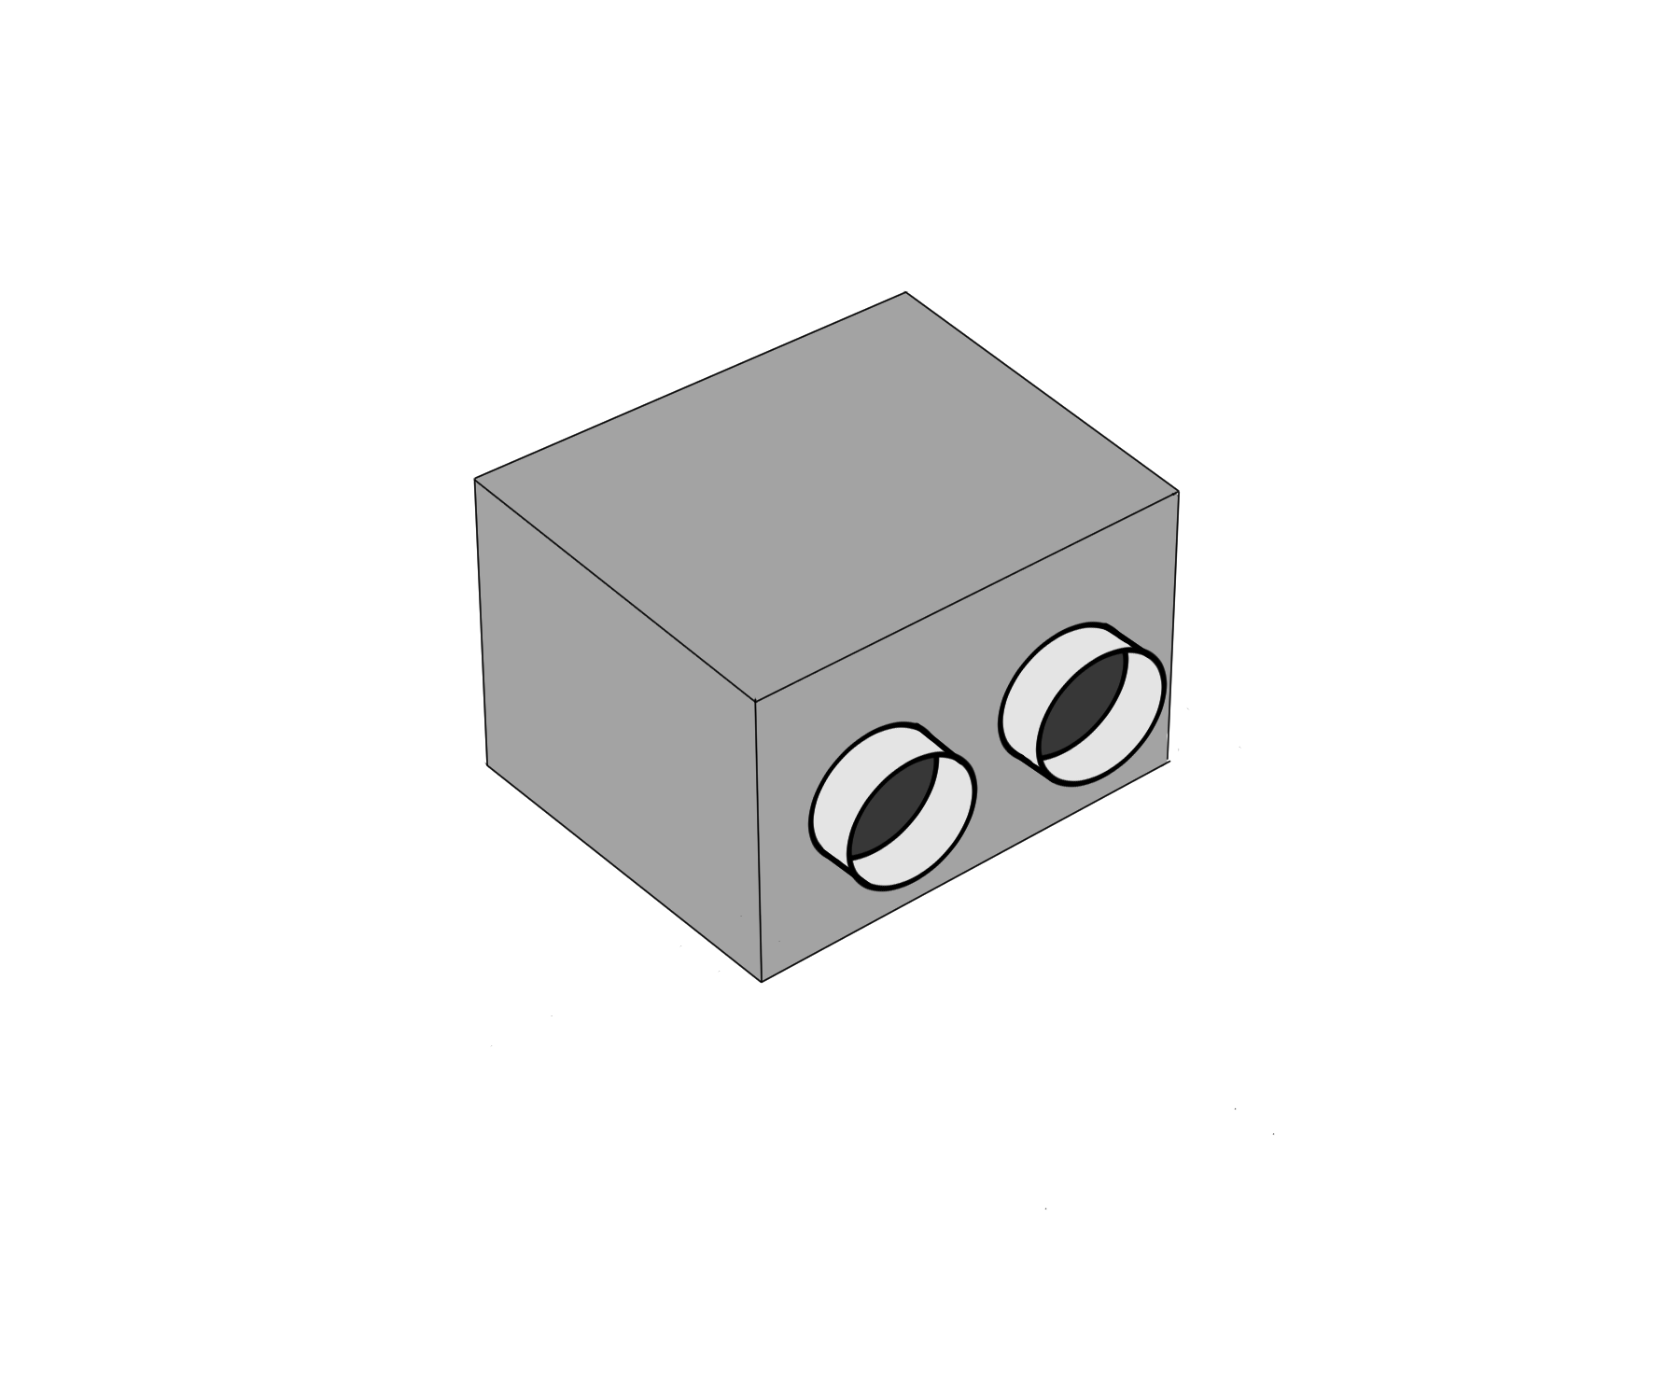
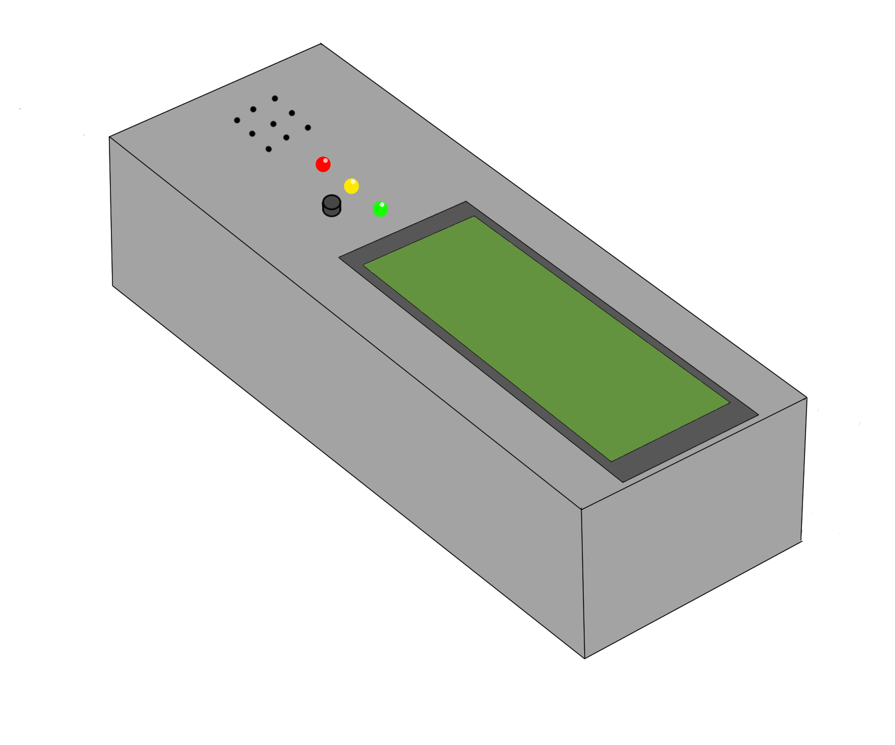
Mechanical Diagram

Slide 14
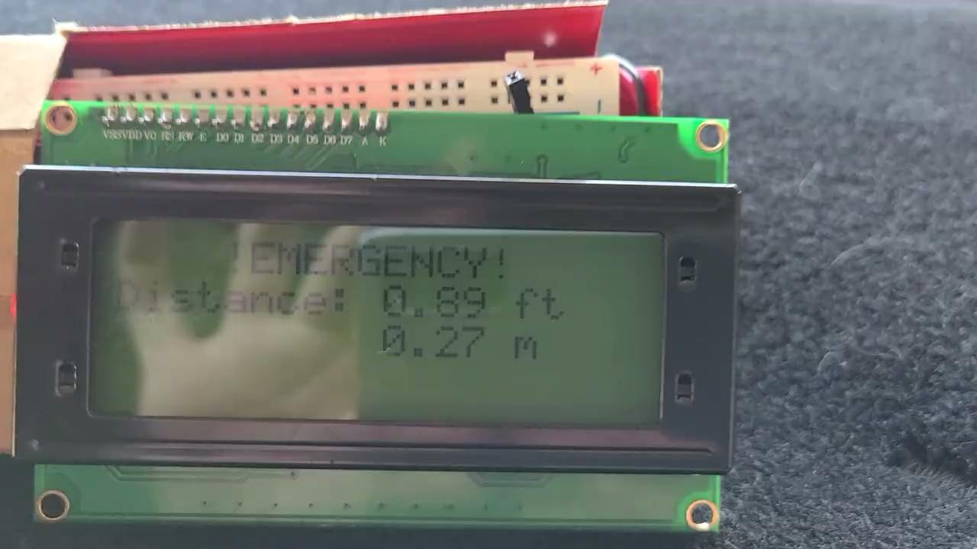
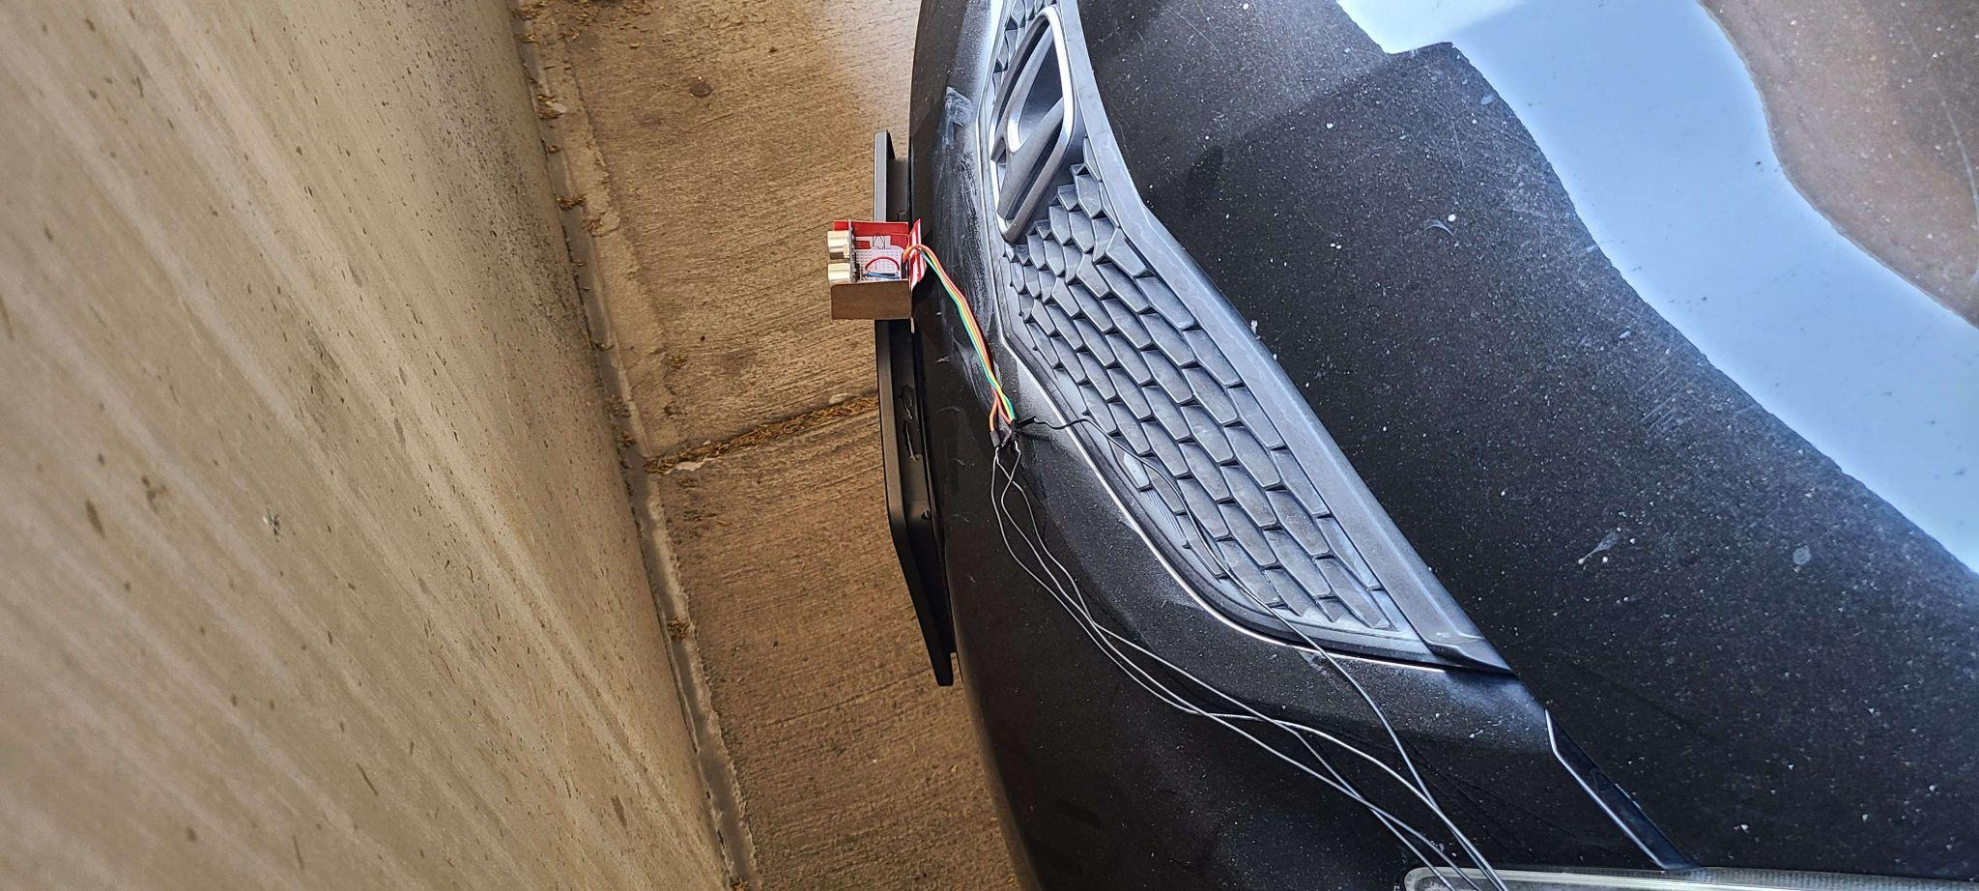
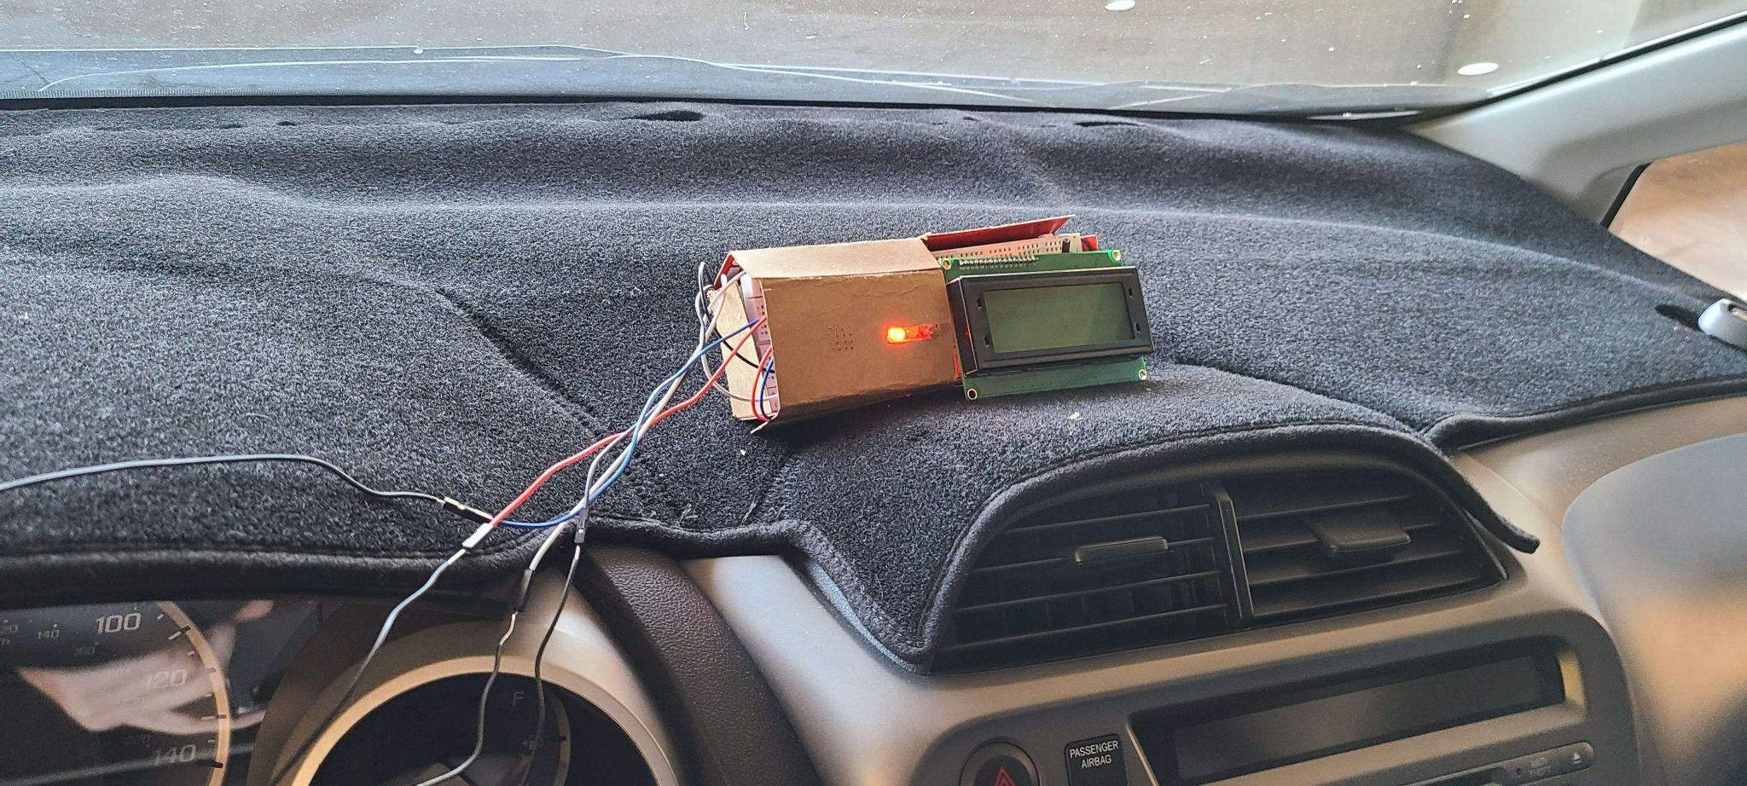

Slide 15
Battery Usage
9V Battery:
Red LED uses 98 mA.
Yellow LED uses 88 mA.
Green LED uses 94 mA.
Standard 9V battery is about 500 mAh.
On average 5 ½ hours of continuous run time from one battery.
In power saving mode around 7 hours of continuous run time is expected

Slide 16
Bill of Materials
HC - SR04 Ultrasonic Sensor - $2
220 ohm resistor - 12₵ x 3
Active buzzer - 70₵
Button - 5₵
Red, Yellow, Green LED - 1₵ for 3.
HiLetgo 20x4 I2C LCD - $10
Total: $13.12

Slide 17
Criteria
Criteria | Level 4 | Level 3 | Level 2 | Level 1 | Result
LEDs & Buzzer | Correct color led turns on for specified distance and buzzer turns on at correct distance | Leds turn on but at wrong times, buzzer turns on when red led turns on | Leds turn on but at wrong times, buzzer turns on at wrong time | LEDs do not turn on and buzzer does not turn on | 4
Ultrasonic Sensor | No external libraries used to measure distance and calculates distance correctly | External libraries used to measure distance and calculates distance correctly | Sensor calculates incorrect distance | Sensor does not work | 4
LCD | No external libraries used to display text using I2C | Uses external libraries to display text | LCD does not use i2c and displays text | LCD does not function | 4
Button | Able to activate power saving mode and wake system up when pressed again | Button activates power saving mode but is not debounced correctly | Button causes interrupt but does not cause power saving mode to activate | Button does not function | 4
Battery powered | Board is able to run off of one 9V battery | N/A | N/A | Board does not use 9V battery | 4

Slide 18
Summary & Next Steps
Summary:
Ultrasonic sensor can accurately measure the distance between itself and an object.
The LCD can display information accurately and also utilize the I2C communication protocol.
The LEDs and buzzer activated at the appropriate times.
A button can send the system into power save mode.
An external battery powers the entire system
Next Steps:
Better Sleep/Power Save Mode
Use a timer interrupt that detects if the device has been inactive for a certain amount of time and then turn off until button is hit to wake up again.
Better Packing for the device
The sensor needs a better mounting system that is compatible with a wide range of cars. The display case could be more compact.
HC - SR04 Ultrasonic Sensor upgrade
Either a new wireless sensor or a way to make the current sensor wireless to eliminate the need to feed wires into the driver's side of car.

